Slide 1
NexTSS: Transcription Start Site Annotation
ML Pipeline construction
Group 4: Ashita Jawali, Sofia Lima, Sanat Mishra, Parker Simpson

Slide 2
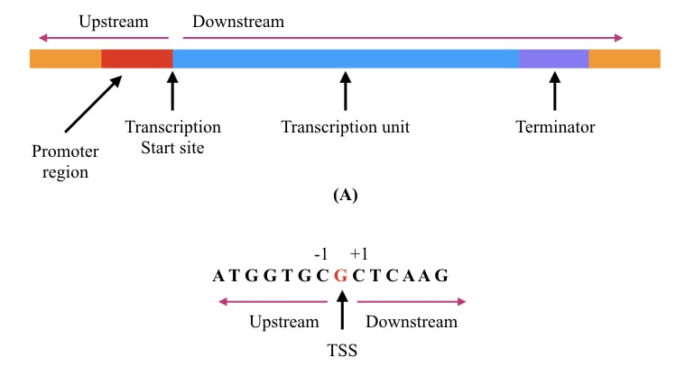
Motivation
TSS prediction problems - heterogeneity of sites within promoters, tissue-specific promoters
Cap Analysis of Gene Expression (CAGE) is informative of transcription start sites
Computational methods are required to improve signal-to-noise ratio in CAGE peak data

Slide 3
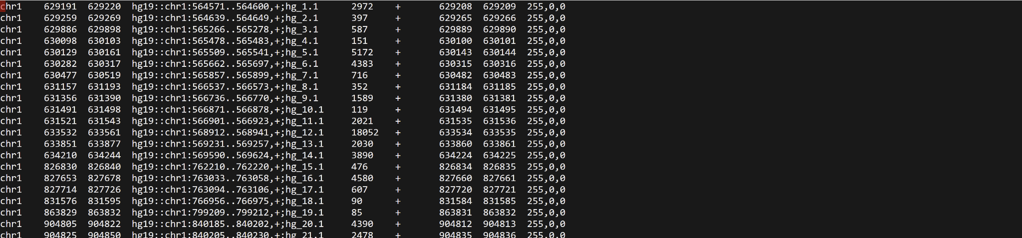
Peeking at CAGE-seq data
Inherently noisy, represent the number of CAGE tags that mapped to a region

Slide 4
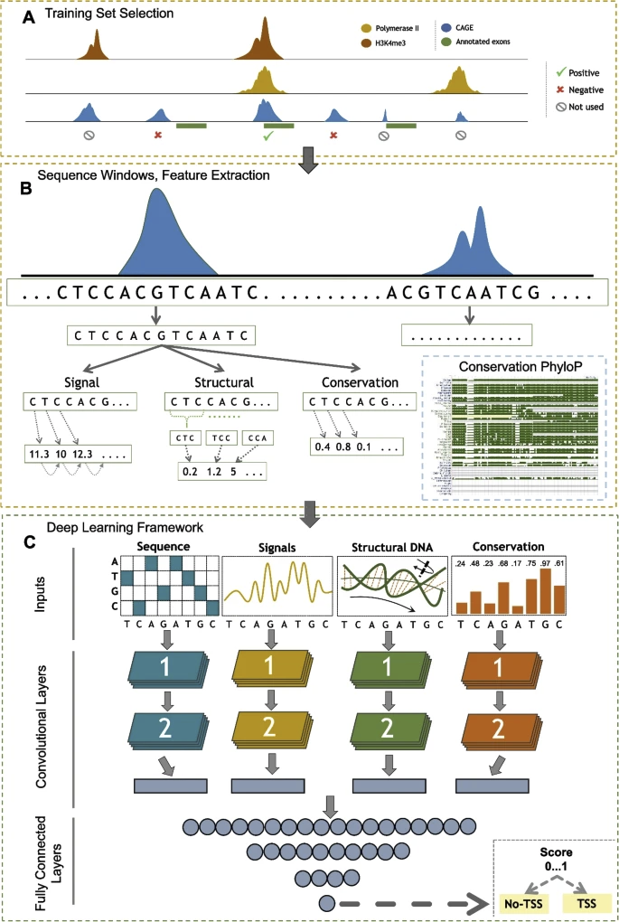
Background
DeepTSS is a computational method for processing CAGE data and predicting single nucleotide TSS with Deep Learning
Trained on one cell type tested on another
Binary labels are determined by overlap with active chromatin and ChIP-Seq (TF) enriched loci
Features: one-hot encoded DNA sequence, GSP, structural, conservation
Results show good performance of TSS prediction where
Genomic Signal Processing (GSP) methods transform DNA strings to numerical data.
Figure 1:Overview of training set selection, feature extraction and DeepTSS DL architecture
Notes:
Discuss differences
(N=11,304) for positive and negative (N=11,579) H3K4me3 and Polymerase II

Slide 5
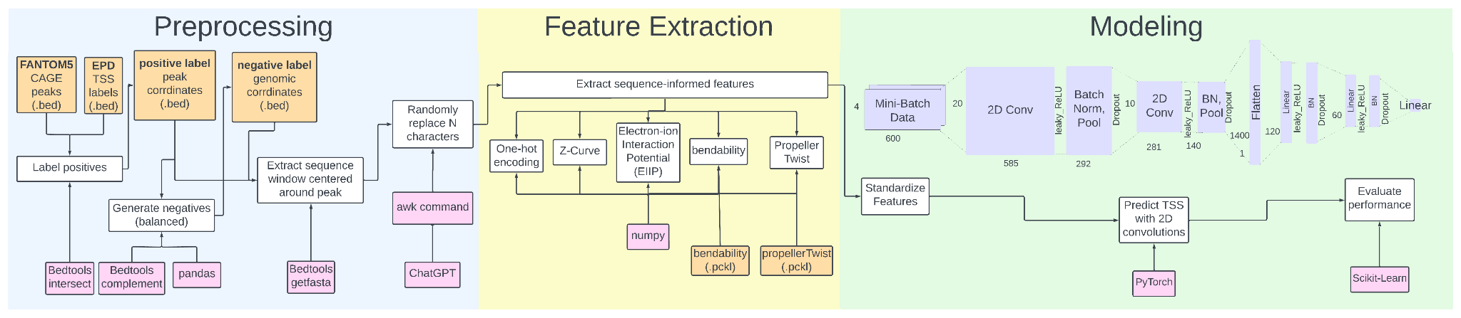
Pipeline Overview
Modeling Goal: Binary TSS prediction of 600bp input
Biological Goal: Train on human CAGE-peak windows and test on mouse

Slide 6
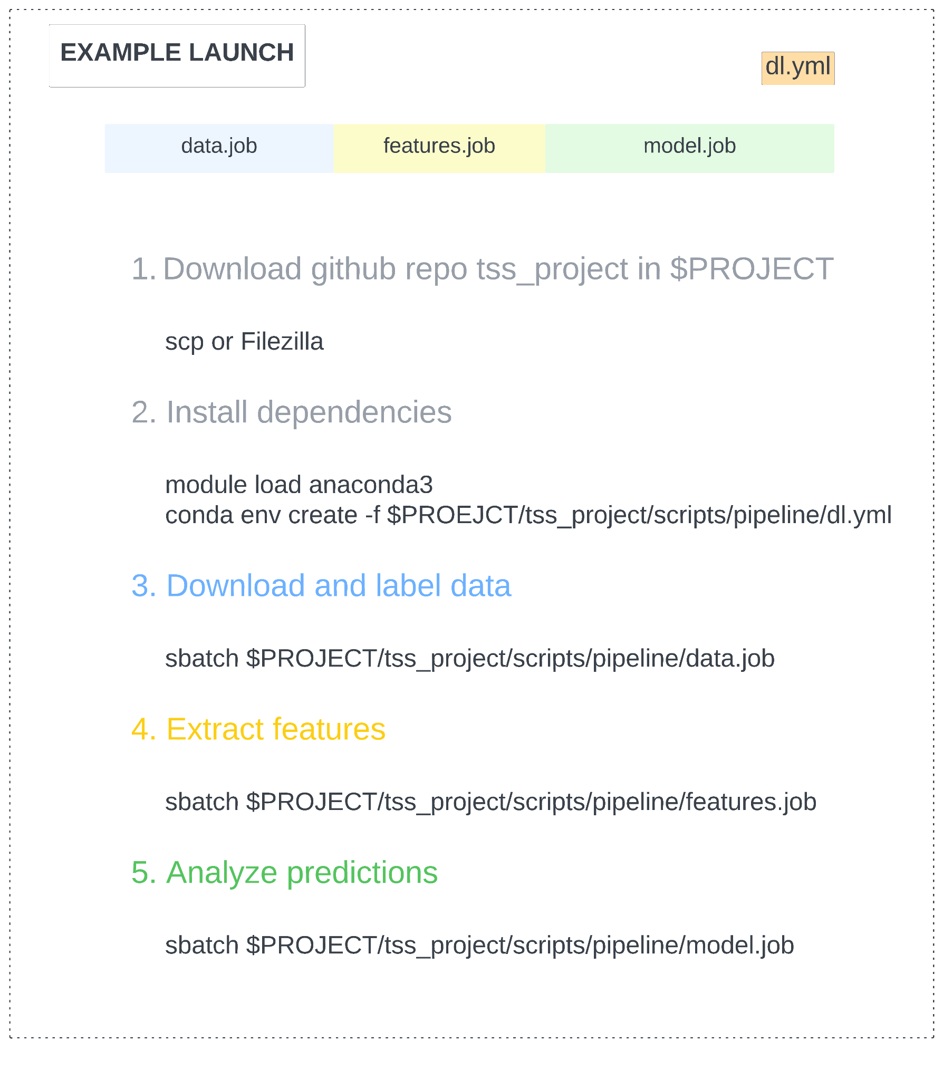
Example launch
One .yml file
Three job scripts

Slide 7
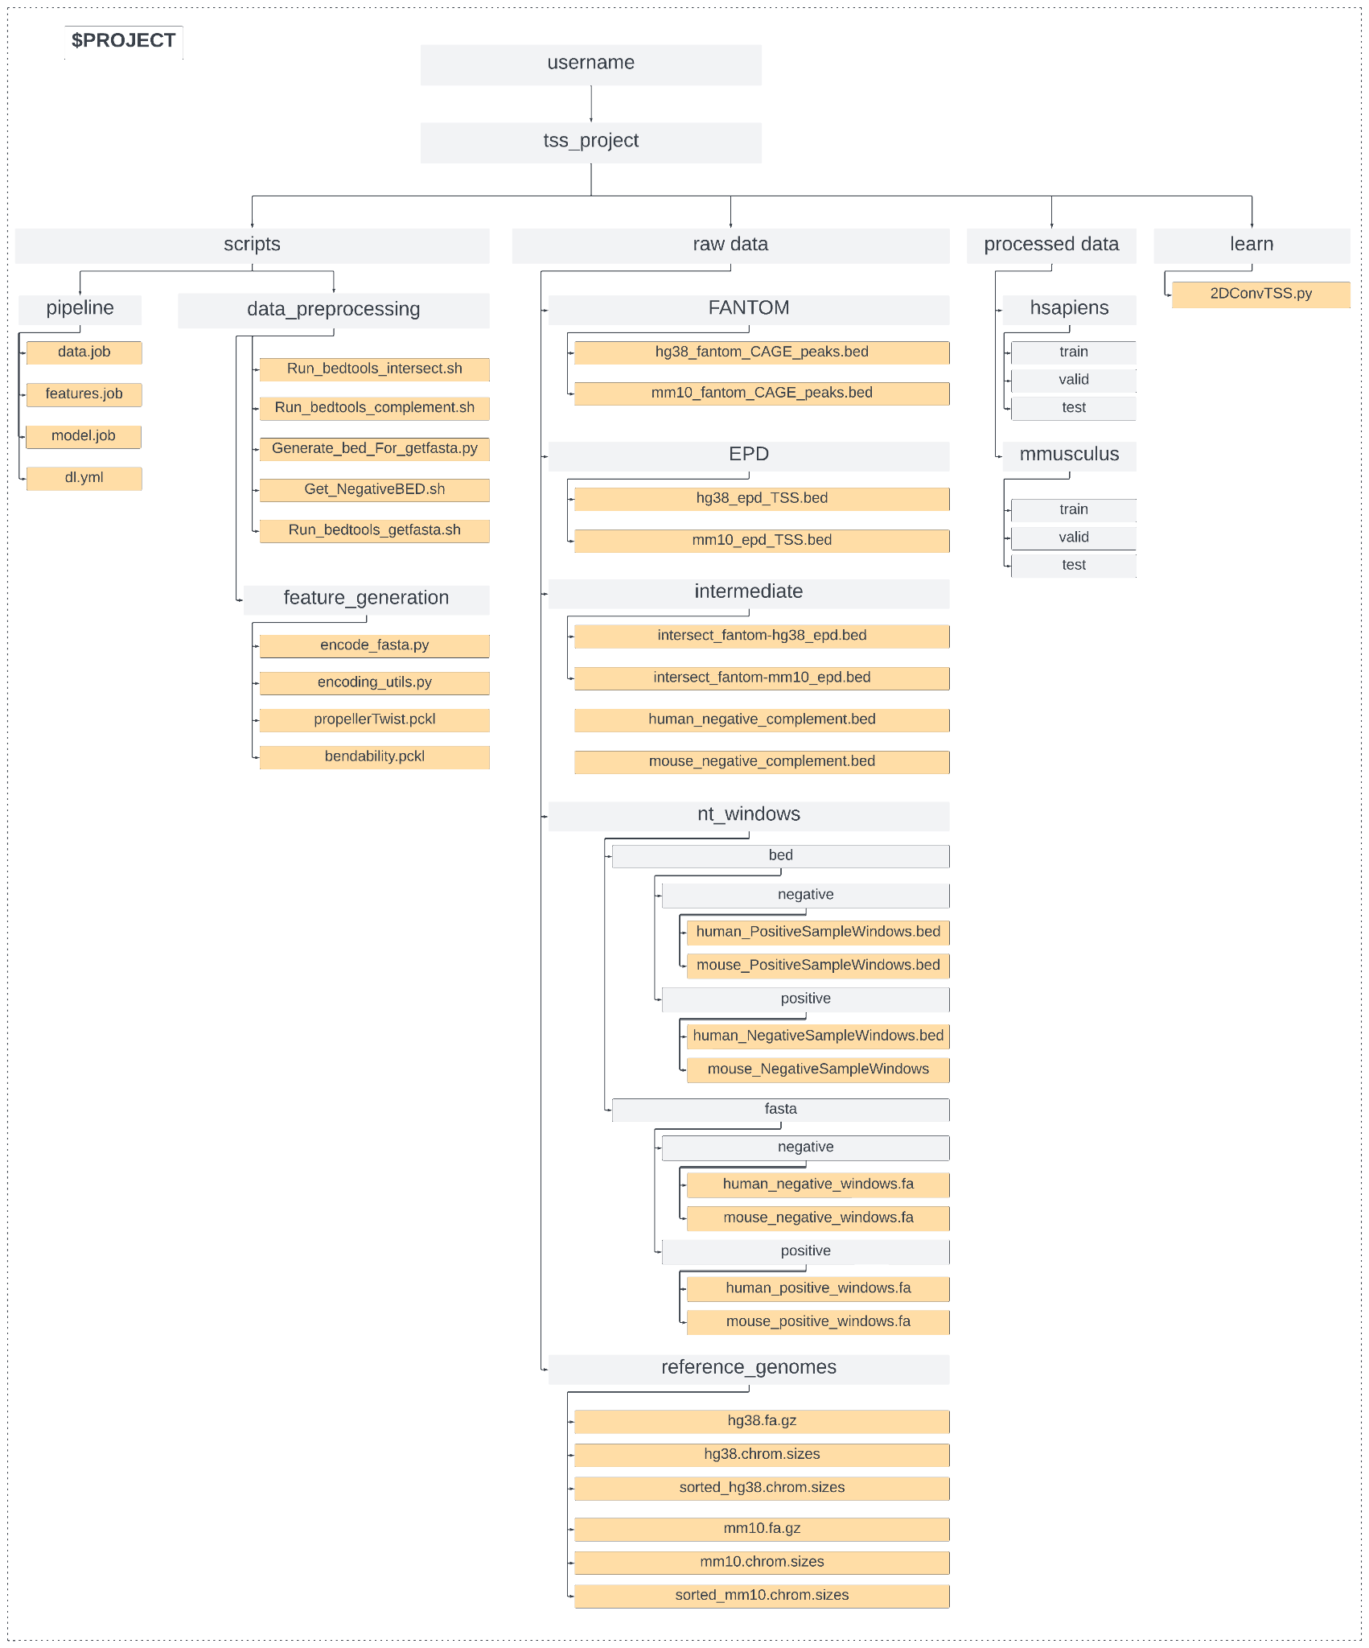
Example launch
Download github repository in $PROJECT directory

Slide 8
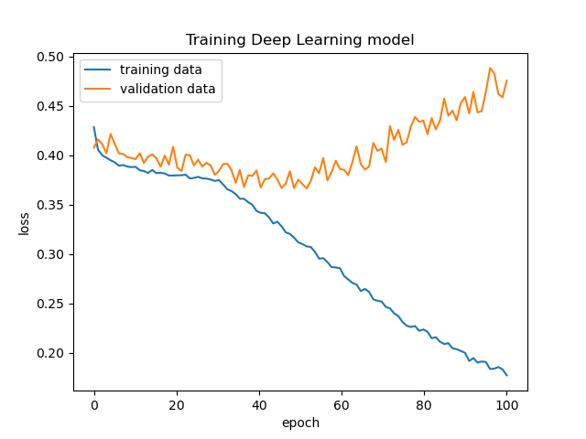
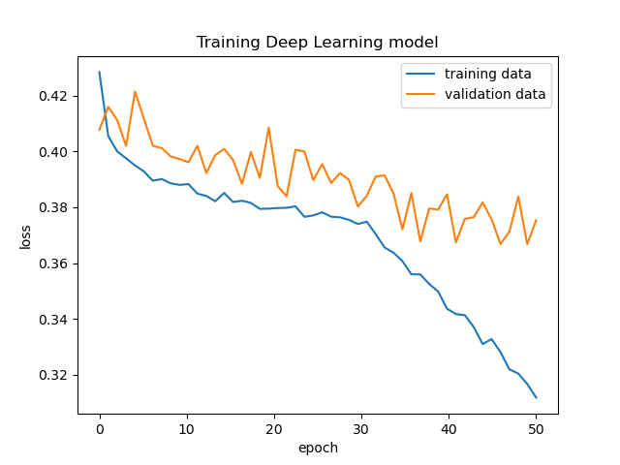
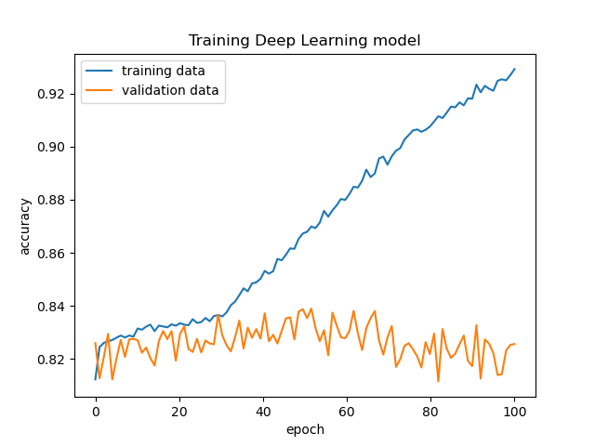
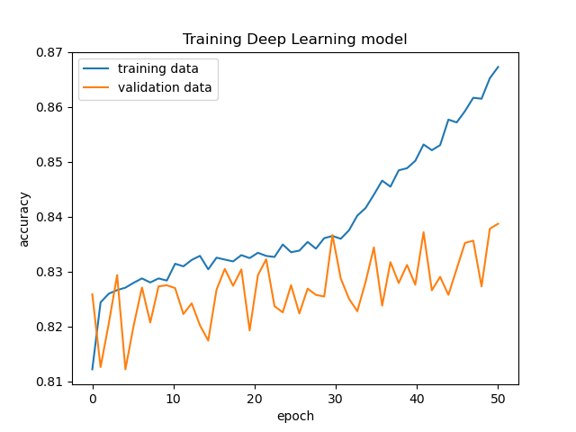
Training with V1 Dataset
100 Epochs
50 Epochs

Slide 9
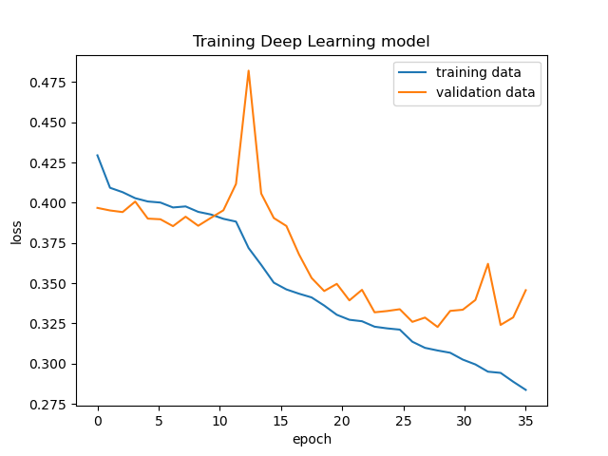
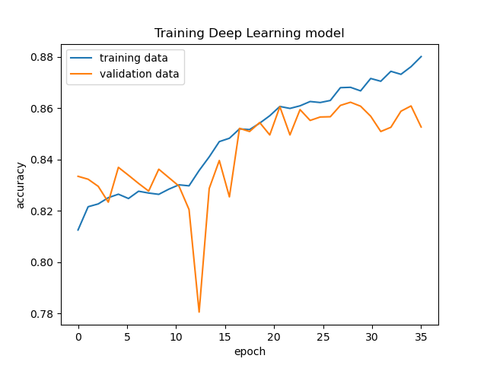
Training with V2 dataset

Slide 10
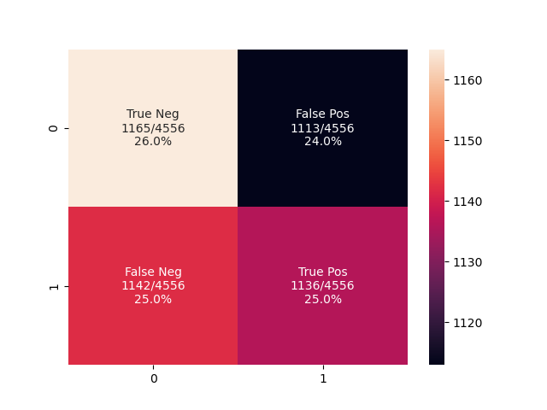
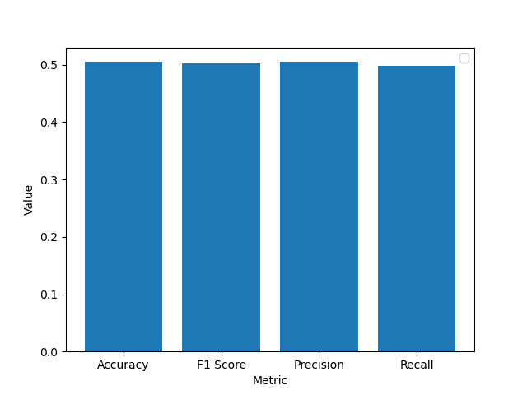
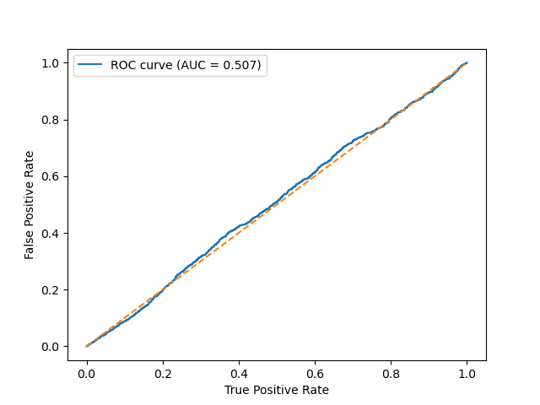
Testing V2 model on H. sapiens data

Slide 11
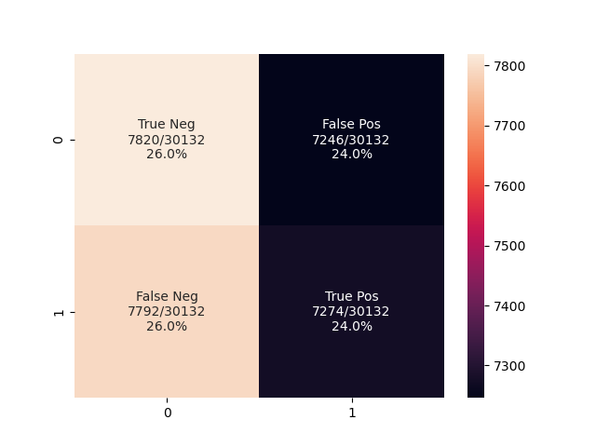
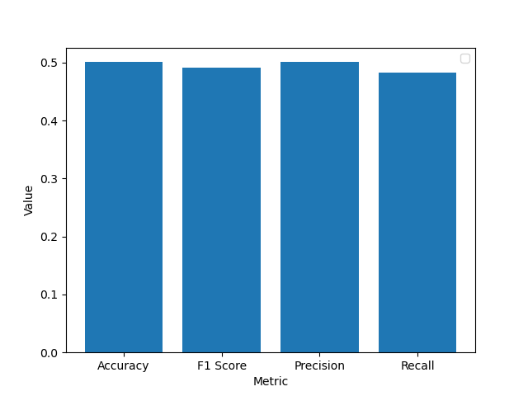
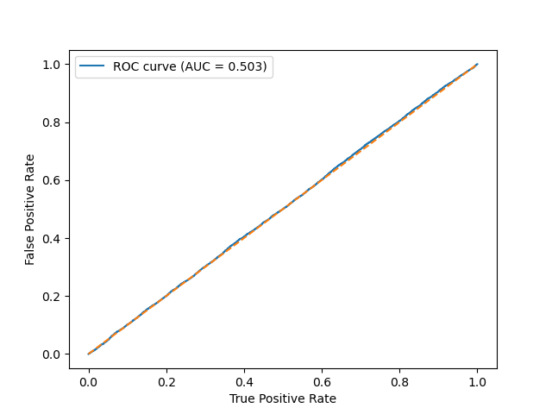
Testing V2 model on M. musculus data

Slide 12
Future Directions
Incorporate peak score in FANTOM data as a feature
Utilise a conservation score as a feature to improve generalizability of model
Evaluate performance of model by overlapping TFBS to benchmark with DeepTSS

Slide 13
References
Grigoriadis, Dimitris, et al. "DeepTSS: multi-branch convolutional neural network for transcription start site identification from CAGE data." BMC bioinformatics 23.2 (2022): 1-17.
Mendizabal-Ruiz, Gerardo, et al. "Genomic signal processing for DNA sequence clustering." PeerJ 6 (2018): e4264.
Borrayo, Ernesto, et al. "Genomic signal processing methods for computation of alignment-free distances from DNA sequences." PloS one 9.11 (2014): e110954.
Kwan, Hon Keung, and Swarna Bai Arniker. "Numerical representation of DNA sequences." 2009 IEEE International Conference on Electro/Information Technology. IEEE, 2009.
Randhawa, Gurjit S., Kathleen A. Hill, and Lila Kari. "ML-DSP: Machine Learning with Digital Signal Processing for ultrafast, accurate, and scalable genome classification at all taxonomic levels." BMC genomics 20 (2019): 1-21.
Bonidia, Robson P., et al. "MathFeature: feature extraction package for DNA, RNA and protein sequences based on mathematical descriptors." Briefings in bioinformatics 23.1 (2022): bbab434.
Berger, John A., et al. "Visualization and analysis of DNA sequences using DNA walks." Journal of the Franklin Institute 341.1-2 (2004): 37-53.
Bonidia, Robson Parmezan, et al. "Feature Extraction Approaches for Biological Sequences: A Comparative Study of Mathematical Models." bioRxiv (2020): 2020-06.
Hoang, Tung, Changchuan Yin, and Stephen S-T. Yau. "Numerical encoding of DNA sequences by chaos game representation with application in similarity comparison." Genomics 108.3-4 (2016): 134-142.

Slide 14
Thank you!

